Slide 1
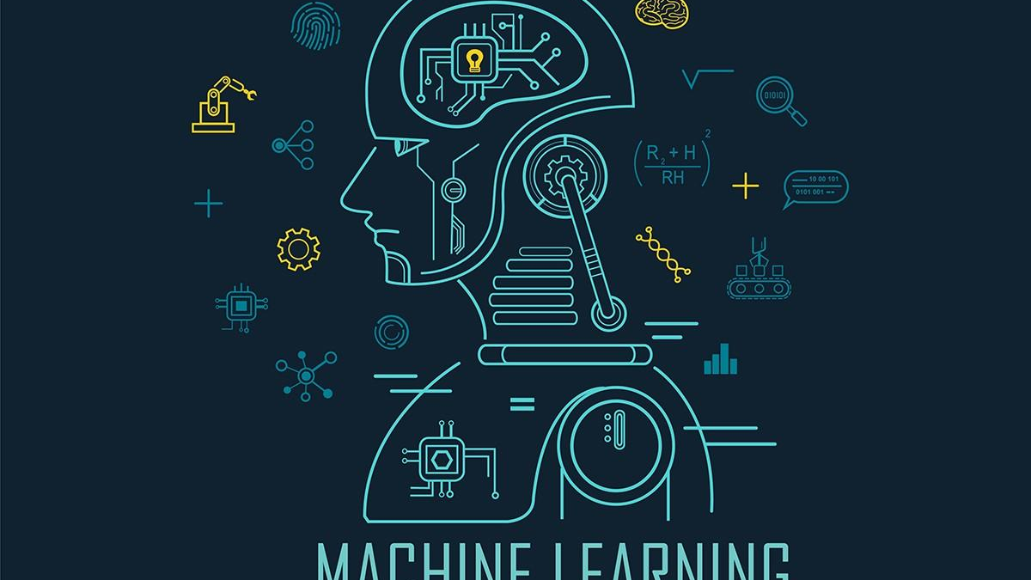
Project Exhibition
Domain-Machine Learning

Slide 2
Introduction to Team Number 58
JIGYASA SHUKLA- 21BAI10160
PURVA SAMAR- 21BAI10356
VAIBHAV ANAND-21BAI10136
RIKKU PRASAD-21BAI10488
SWARNANKITA SAHA-21BAI10436

Slide 3
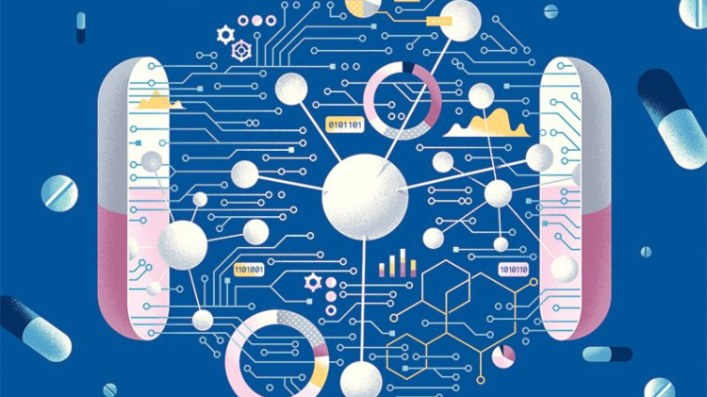
INDEX
Abstract
Topic of the Project
Problem Statement
Hardware/Software Requirement
Architectural Diagram
Usability of the Project
Contribution of Each Member

Slide 4
Abstract
The proliferation of computerized technology in the healthcare industry has led to the accumulation of electronic data. With so much data, doctors face the challenge of accurately analyzing symptoms and recognizing disease early.
However, supervised machine learning (ML) algorithms have shown great potential to surpass standard disease diagnostic systems and help medical professionals detect high-risk diseases early.
The purpose of this literature is to identify trends in different types of supervised ML models in disease detection by examining performance metrics.
The most prominently discussed supervised ML algorithms were Naive Bayes (NB), Decision Trees (DT), and K-Nearest Neighbors (KNN).

Slide 5
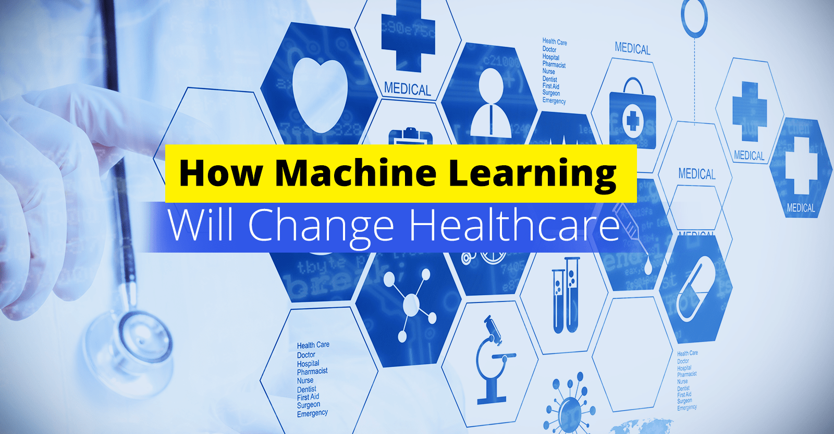

Slide 6
INTRODUCTION
People today suffer from a variety of illnesses due to the current state of the environment and their lifestyle. Early detection and prediction of such diseases is important to prevent them from progressing to the final stages.
Doctors usually find it difficult to pinpoint complaints by hand. There are several machine learning techniques that perform predictive analytics on large amounts of data used in different industries. Predictive analytics helps physicians make accurate decisions about a patient's health and treatment based on the vast amount of data available, but overall it is a very difficult process.
Several diseases such as cancer and diabetes are becoming leading causes of death worldwide and the most common reason is the lack of early detection of these diseases. The lack of good healthcare infrastructure and the low proportion of doctors in the population are also important factors.
WHO recommendations should have a doctor-to-patient ratio of 1:1000, but in India the ratio is 1:1456, indicating a shortage of doctors in India. Early detection and diagnosis of these diseases is therefore very important to save many lives.

Slide 7
This work is about disease prediction using machine learning algorithms. As technology advances, greater computing power and availability of datasets in open source repositories provide even more access to data to leverage machine learning. As a result, machine learning is widely used in healthcare.
Healthcare generates large amounts of data, such as images and patient data, that can help identify and predict patterns. Machine learning is used in medicine to solve a variety of real-world problems that require time-sensitive and individual expertise.
The purpose of this study is to identify and predict patients with more common diseases. This is achieved by using state-of-the-art machine learning techniques to enable classification to accurately identify people with the disease.
Disease prediction is also a difficult task, as there are many different diseases with the same type of symptoms. The proposed system is a machine learning algorithm known how Polynomial naive Bayes, Random Forest Classifier, and K-Nearest Neighbors predict disease in your dataset and provide prognosis for a wide range of diseases based on patient symptoms.

Slide 8
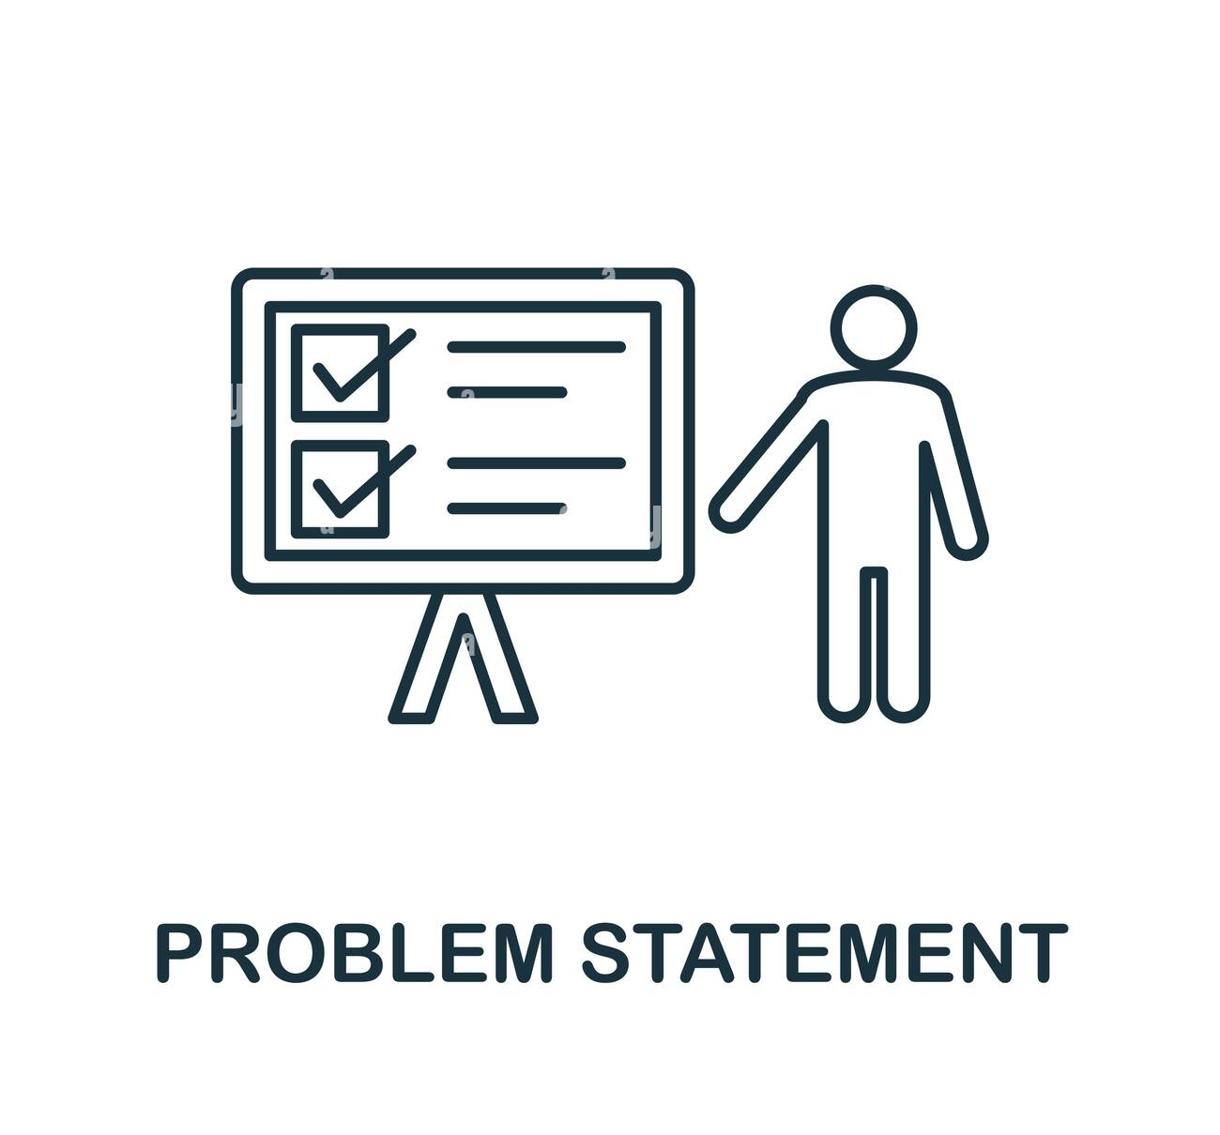
PROBLEM STATEMENT
The conventional approach requires patients a visit to doctor and making appointments to get a diagnosis. In most cases it leads to multiple tests in order to get accurate disease indications. Sometimes patients have to wait for test results like blood reports. This process takes up precious time of patients as well as doctors.

Slide 9
ㅤ
Through this project we aim to propose a disease prediction system which depends on the input from the user to bring forth probable diagnosis.
When we are not feeling well the first thing we do is to check our temperature to get an estimate or baseline idea of our fever so we can consult our doctor if the temperature is high enough similarly a medical disease prediction application can be used to get a baseline idea of disease and can indicate us whether we should take immediate doctor consultation or not, or at least start some home-remedies for the same to find temporary relief.
Combining machine learning with an application interface to interact with users provides opportunities for easy interaction with the users with the machine learning model to get more accurate predictions.

Slide 10

HARDWARE/SOFTWARE REQUIREMENTS
PROCESSOR-11th Gen Intel(R) Core(TM) i7 (H)
GRAPHICS PROCESSING UNIT(GPU)-Intel(R) Iris(R) Xe Graphics, 1024 MB (H)
MEMORY-128GB (H)
OPERATING SYSTEM-Microsoft Windows 11 Home Single Language 64-bit (S)
PROGRAMMING LANGUAGE-PYTHON (S)
DEEP LEARNING LIBRARY-KAGGLE DATASET (S)

Slide 11
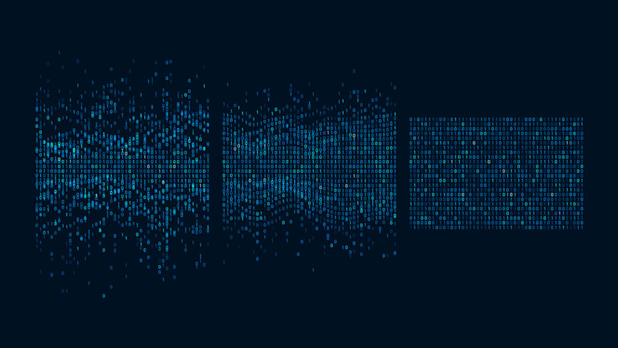
ARCHITECTURAL DIAGRAM

Slide 12
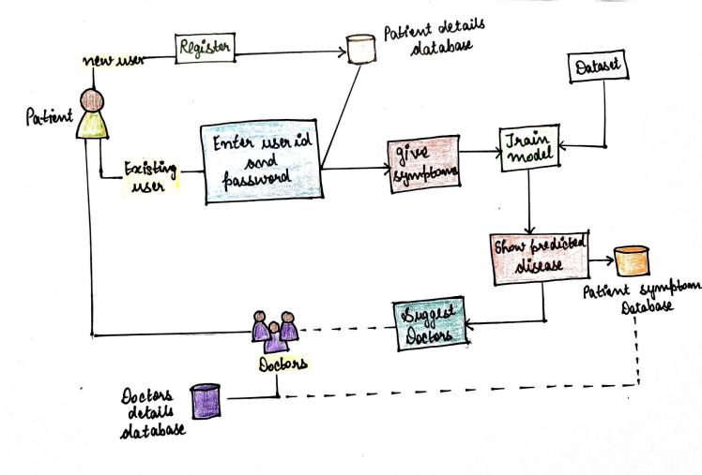

Slide 13
MODULES OF THE PROJECT
GATHERING THE DATA-Data preparation is the primary step for any machine learning project.
CLEANING THE DATA-Cleaning is the most important step in a machine learning project.
MODEL BUILDING-After gathering and cleaning the data, the data is ready and can be used to train a machine learning model.
INFERENCE-After training the three models we will be predicting the disease for the input symptoms by combining the predictions of all three models. This makes our overall prediction more robust and accurate.

Slide 14
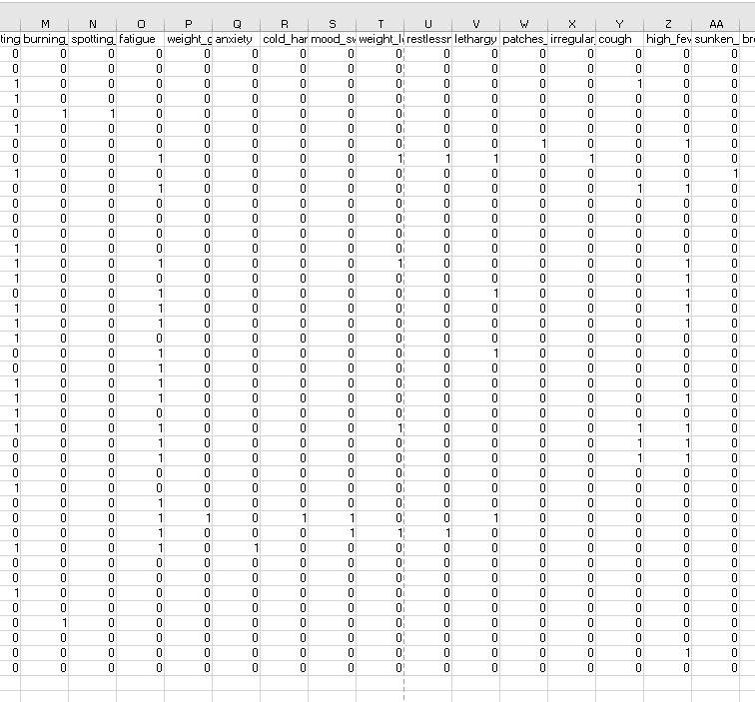
MODULE 1- GATHERING THE DATA
We will be using dataset from Kaggle for this problem. This dataset will include two files one for training and the other for testing. This dataset could be an information database of disease symptom associations generated by discharge summaries of various hospitals and doctors.

Slide 15
MODULE 2-CLEANING THE DATA
The quality of our data determines the quality of our machine learning model.So it is always necessary to clean the data before feeding it to the model for training.
In our dataset all the columns are numerical, the target column are numerical, i.e prognosis is the string type and is encoded to numerical form using label encoder.
The labels in the dataset are converted into machine readable form.

Slide 16
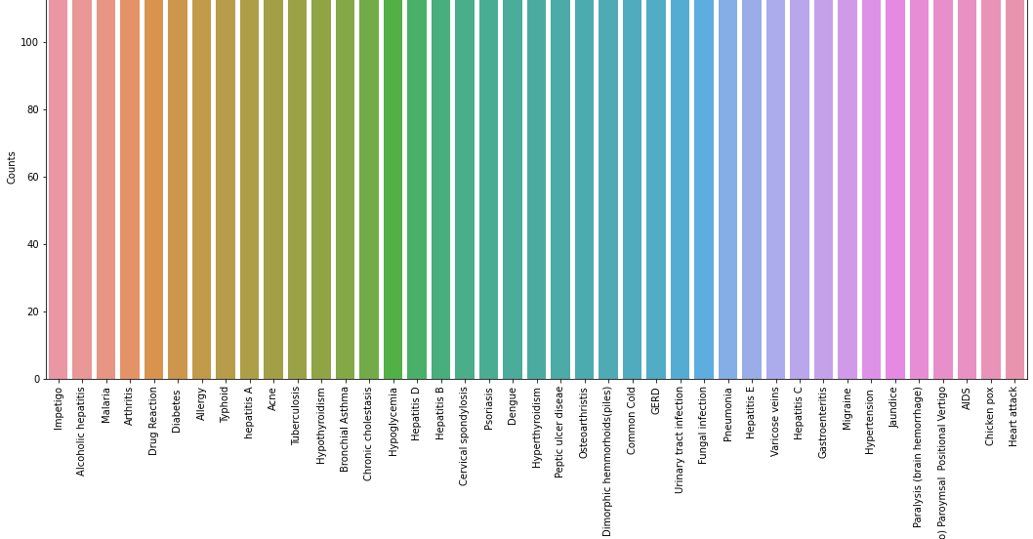

Slide 17
MODULE 3-MODEL BUILDING
Support Vector Classifier,Naive Bayes Classifier and Random Forest Classifier will be used to train the dataset.We will be using K-Fold cross-validation to evaluate the machine learning models.
K-Fold cross-validation is one of the cross-validation techniques in which the whole dataset is split into k number of subsets, also known as folds, then training of the model is performed on the k-1 subsets and the remaining one subset is used to evaluate the model performance.
Support Vector Classifier is a discriminative classifier i.e. when given a labeled training data, the algorithm tries to find an optimal hyperplane that accurately separates the samples into different categories in hyperspace.

Slide 18
Gaussian Naive Bayes Classifier: It is a probabilistic machine learning algorithm that internally uses Bayes Theorem to classify the data points.
Random Forest is an ensemble learning-based supervised machine learning classification algorithm that internally uses multiple decision trees to make the classification.

Slide 19
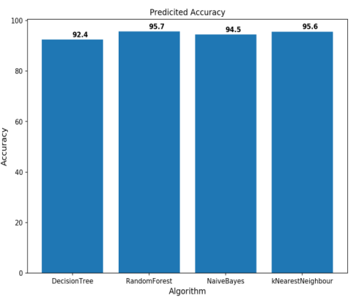
MODULE 4-INFERENCE
The feature extracted data is further evaluated to predict the disease by using the classifiers such as Random forest and Naïve Bayes Classifiers, Decision tree, K-Nearest Neighbour.
On comparing the four machine learning algorithms, K Nearest Neighbour shows 95.6%, Naïve Bayes Classifiers shows 94.5%, Random Forest model has the highest accuracy of 95.7% than the Decision Tree algorithm shows 92.4%.
The results were evaluated with accuracy, sensitivity, specificity, positive predictive value and negative predictive value.

Slide 20
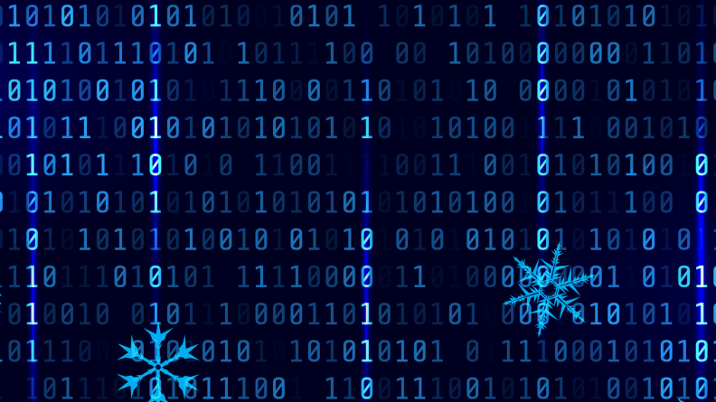
IMPLEMENTATION SCREENSHOTS

Slide 21
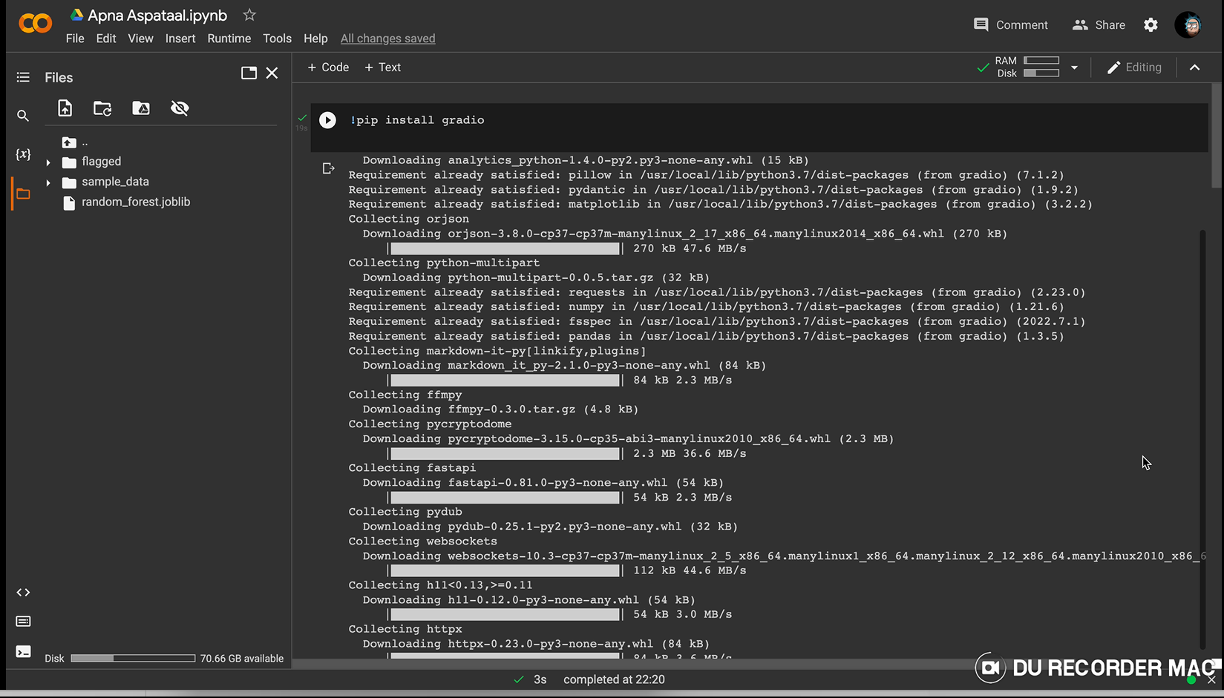

Slide 22
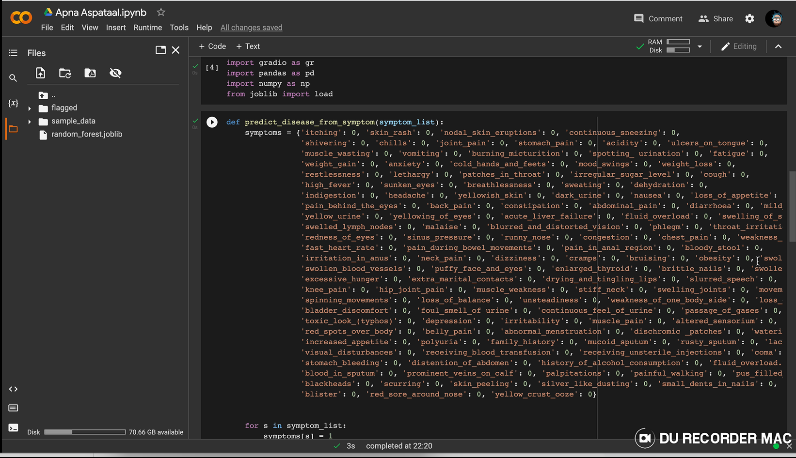

Slide 23
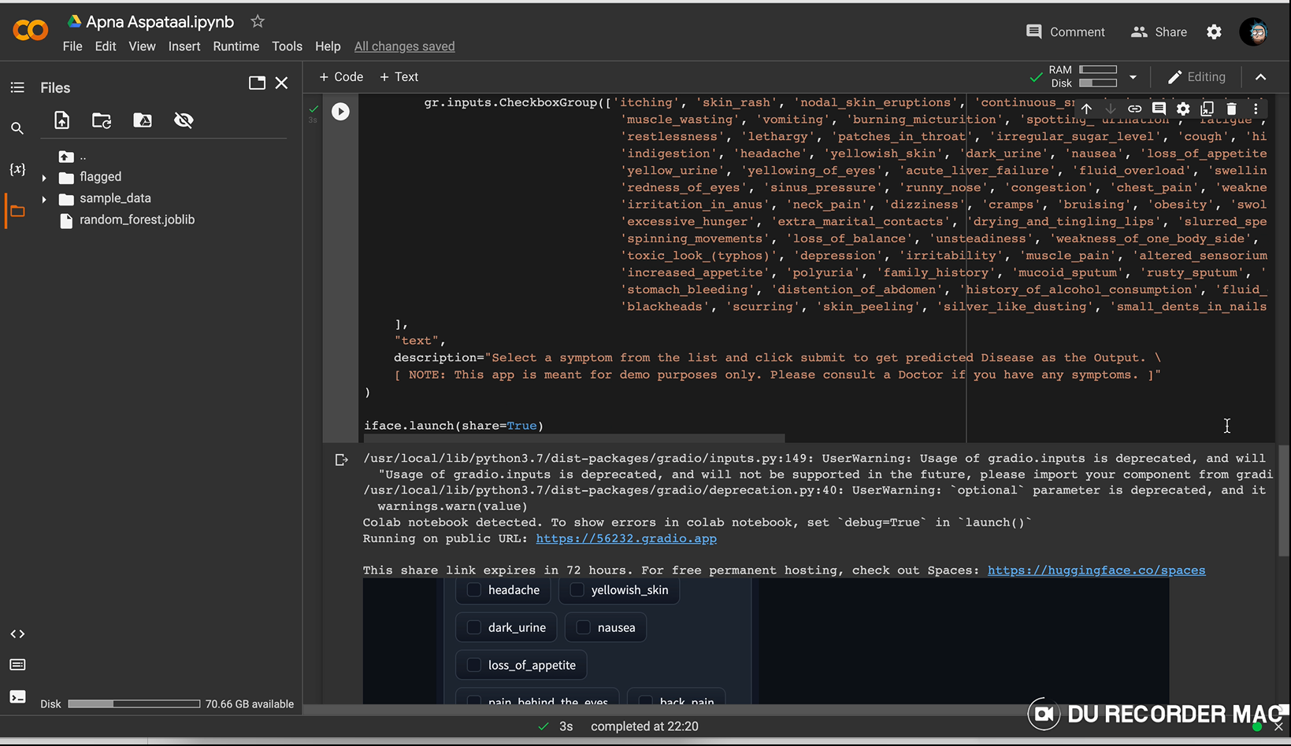

Slide 24
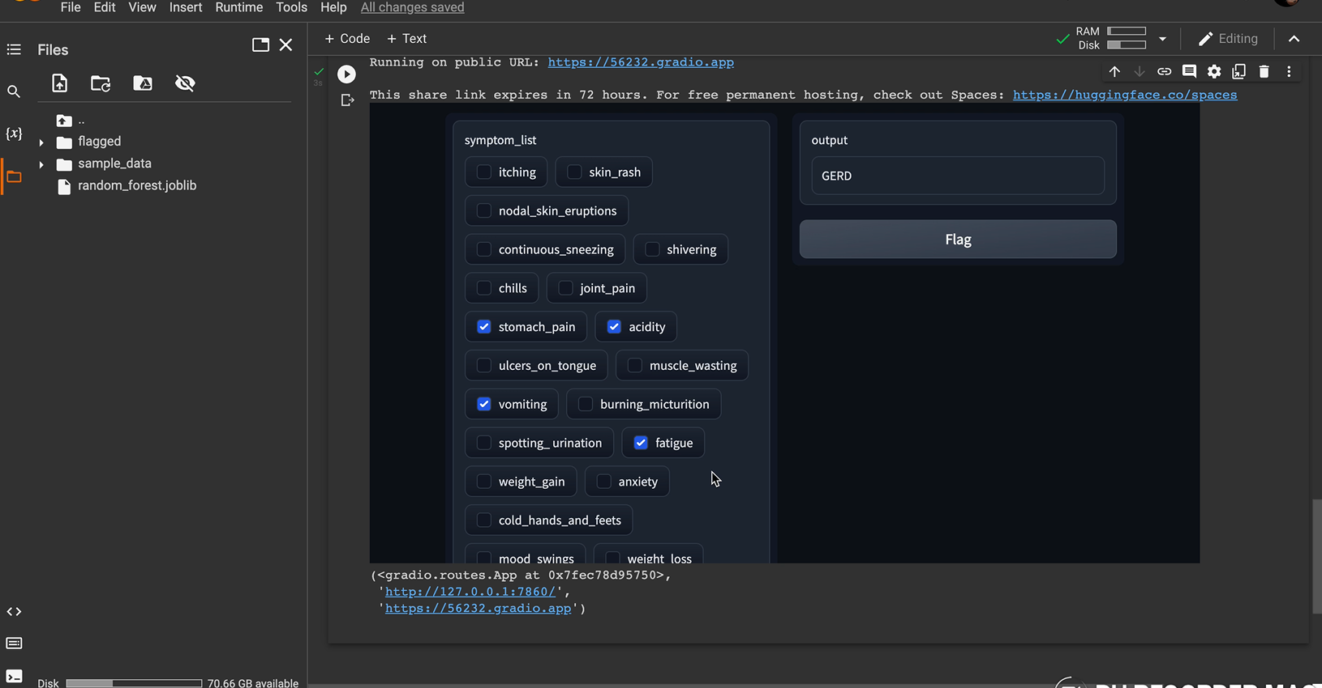

Slide 25
USABILITY OF THE PROJECT
It can be useful for the students who are studying medicine for predictive assessment of any illness.
It can give an idea for emergency usage of any generic medicine.
It can be useful for suggesting the best possible doctors for the best possible results.
It can be useful for maintaining medical records of the patients to reduce workload of doctors.

Slide 26
REFERENCES
Disease and symptoms Dataset from Kaggle
Nivethitha.A, Narendran.G, Pramoth Krishnan.T, ‘Smart Disease prediction Using Machine Learning’.
www.github.com
Priyanka J.Panchal, Shaeezah A. Mhaskar, Tejal S.Ziman, ‘Disease Prediction using Machine Learning’
Research Gate
IJRASET
Disease Prediction Project in Python GUI using ML

Slide 27
CONTRIBUTION OF EACH MEMBER
JIGYASA SHUKLA-Presentation, Research and assisting in web development
PURVA SAMAR- Presentation, Research and web development
RIKKU PRASAD-Architectural Diagram and assisting in app development
VAIBHAV ANAND-Research and app development
SWARNANKITA SAHA-Research and assisting in web development

Slide 28
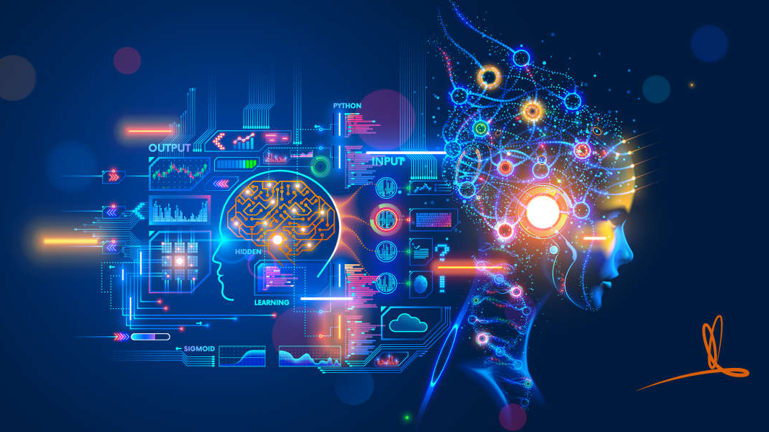
THANK YOU
ㅤ

